Slide 1
Chapter 7 Why Do Financial
Institutions Exist?

Slide 2
Financial System Overview (2)
Financial Markets
Financial Institutions
Bond Market (3,5,12)
Stock Market (13,6)
Money Market (11)
Mortgage Market (14)
Why Exists (7)
Banking Industry (19)
Mutual Fund Industry(20)
Hedging with Financial Derivatives (24)

Slide 3
Chapter Preview
A vibrant economy requires a financial system that moves funds from savers to borrowers.
But how does it ensure that your hard-earned dollars are used by those with the best productive investment opportunities?

Slide 4
Chapter Outline
Basic Facts About Financial Structure Throughout the World
Transaction Costs
Asymmetric Information: Adverse Selection and Moral Hazard
The Lemons Problem: How Adverse Selection Influences Financial Structure
How Moral Hazard Affects the Choice Between Debt and Equity Contracts
How Moral Hazard Influences Financial Structure in Debt Markets
Conflicts of Interest

Slide 5
Basic Facts About Financial Structure Throughout the World
The financial system is a complex structure including many different financial institutions.
financial institutions
banks
insurance companies
mutual funds
stock markets
bonds markets
Etc.

Slide 6
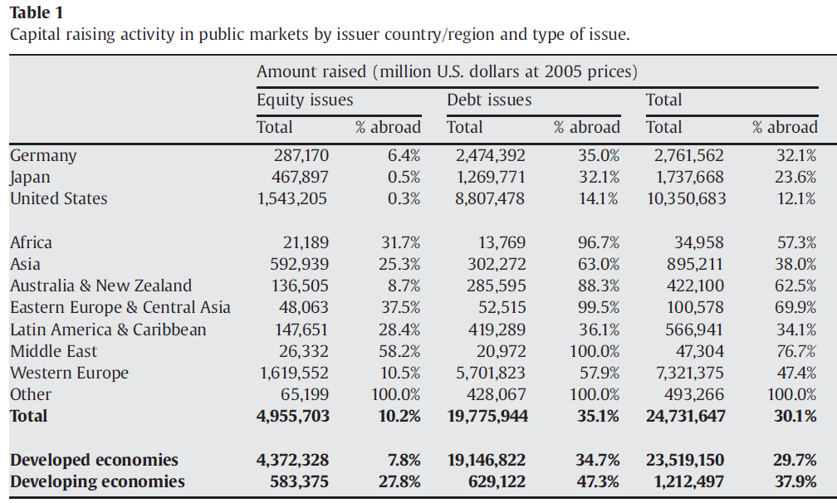
Facts of Financial Structure
Stocks are not the most important source of external financing for businesses.
Gozzi, Levine, Schmukler, 2010

Slide 7
Facts of Financial Structure
Issuing marketable debt and equity securities is not the primary way in which businesses finance their operations.
Indirect finance, which involves the activities of financial intermediaries, is many times more important than direct finance, in which businesses raise funds directly from lenders in financial markets.
Financial intermediaries, particularly banks, are the most important source of external funds used to finance businesses.

Slide 8
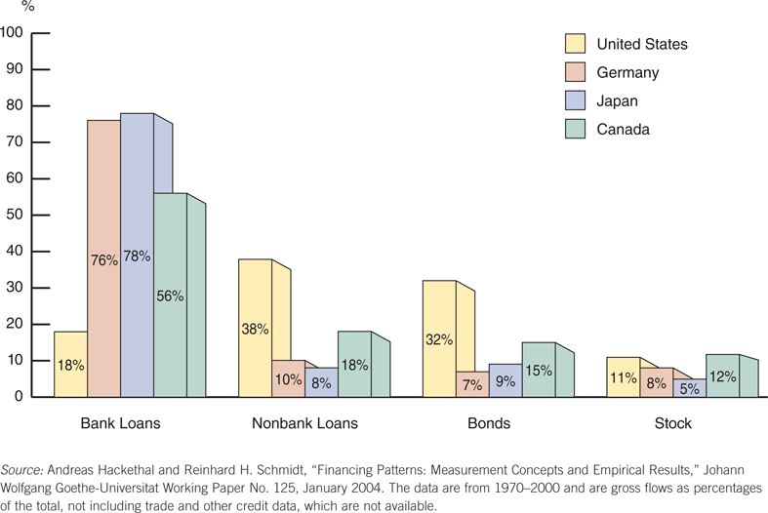
Figure 7.1 Sources of External Funds for Nonfinancial Businesses: A Comparison of the United States with Germany, Japan, and Canada
Insurance co.
Pension funds
Financial co.
Direct finance

Slide 9
#Fact3
43% share of stocks and bonds as a source of external financing for American business overstates the importance of direct finance in US financial system.
Since 1970, less than 5% of bonds and less than 1/3 of stocks are sold directly to American households.
The rest are bought by insurance co., pension funds, mutual funds etc.
Direct finance is used less than 10% of the external findings of American business.

Slide 10
Facts of Financial Structure
The financial system is among the most heavily regulated sectors of economy.
Only large, well-established corporations have easy access to securities markets to finance their activities.
Collateral is a prevalent feature of debt contracts for both households and businesses.
Debt contracts are typically extremely complicated legal documents that place substantial restrictions on the behavior of the borrowers.

Slide 11
Transaction Costs
Transactions costs influence financial structure
E.g., a $5,000 investment only allows you to purchase 100 shares @ $50 / share (equity)
No diversification
Bonds even worse—most have a $10,000 size
Financial intermediaries make profits by reducing transactions costs
Take advantage of economies of scale (example: mutual funds)
Develop expertise to lower transactions costs

Slide 12
Asymmetric Information: Adverse Selection and Moral Hazard
Asymmetric information: a situation that arises when one party’s insufficient knowledge about the other party involved in a transaction makes it impossible to make accurate decisions when conducting the transaction.
To begin to understand the implications of asymmetric information, we will focus on two specific forms:
Adverse selection
Moral hazard

Slide 13
Asymmetric Information: Adverse Selection and Moral Hazard
Adverse Selection
Occurs when one party in a transaction has better information than the other party
Before transaction occurs
Potential borrowers most likely to produce adverse outcome are ones most likely to seek loan and be selected

Slide 14
Asymmetric Information: Adverse Selection and Moral Hazard
Moral Hazard
Occurs when one party has an incentive to behave differently once an agreement is made between parties
After transaction occurs
Hazard that borrower has incentives to engage in undesirable (immoral) activities making it more likely that won't pay loan back

Slide 15
Asymmetric Information: Adverse Selection and Moral Hazard
The analysis of how asymmetric information problems affect behavior is known as agency theory.
We will now use these ideas of adverse selection and moral hazard to explain how they influence financial structure.

Slide 16

The Lemons Problem: How Adverse Selection Influences Financial Structure
Lemons Problem in Used Cars
If we can't distinguish between “good” and “bad” (lemons) used cars, we are willing pay only an average of good and bad car values
Result: Good cars won’t be sold, and the used car market will function inefficiently.
What helps us avoid this problem with used cars?

Slide 17
The Lemons Problem: How Adverse Selection Influences Financial Structure
Lemons Problem in Securities Markets
If we can't distinguish between good and bad securities, willing to pay only average of good and bad securities’ value
Result: Good securities undervalued and firms won't issue them; bad securities overvalued, so too many issued
Investors don't want buy bad securities, so market don't function well
Explains Fact # 1 and # 2
Also explains Fact # 6 : Less asymmetric info for well known firms, so smaller lemons problem

Slide 18
Tools to Help Solve Adverse Selection (Lemons) Problems
Private Production and Sale of Information
Free-rider problem interferes with this solution
Government Regulation to Increase Information (explains Fact # 5)
For example, annual audits of public corporations (although Ernon is a shining example of why this does not eliminate the problem—we’ll discuss that briefly)

Slide 19
Tools to Help Solve Adverse Selection (Lemons) Problems
Financial Intermediation
Example: used cars are not sold directly by one individual to another. Instead, they are sold by an intermediary, a used-car dealer.
Avoid free-rider problem by making private loans (explains Fact # 3 and # 4)
Also explains fact #6—large firms are more likely to use direct instead of indirect financing
Collateral and Net Worth
Explains Fact # 7

Slide 20
Role of Banks
An expert in producing information about firms, so that it can sort out good credit risks from bad ones.
It can acquire funds from depositors and lend them to the good ones.
Banks primarily making private loans, which are not traded. (avoid free rider problem)
The bank’s role as an intermediary that holds mostly nontraded loans is the key to its success in reducing asymmetric information in financial markets.

Slide 21
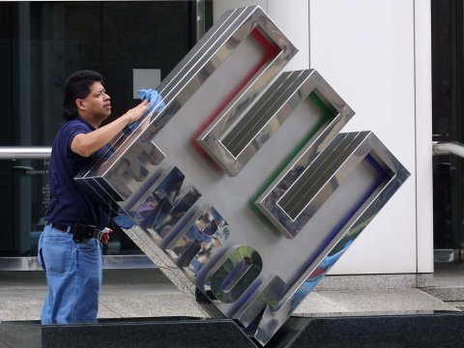
The Enron Implosion
Up to 2001, Enron appeared to be a very successful firm engaged in energy trading.
However, that the firm had severe financial problems, and hid many of its problems in complex financial structures that allowed Enron to not report them.
Even though Enron regularly filed records with the SEC, the problem was not prevented.
Government regulation can lessen asymmetric information problem, but cannot eliminate them

Slide 22
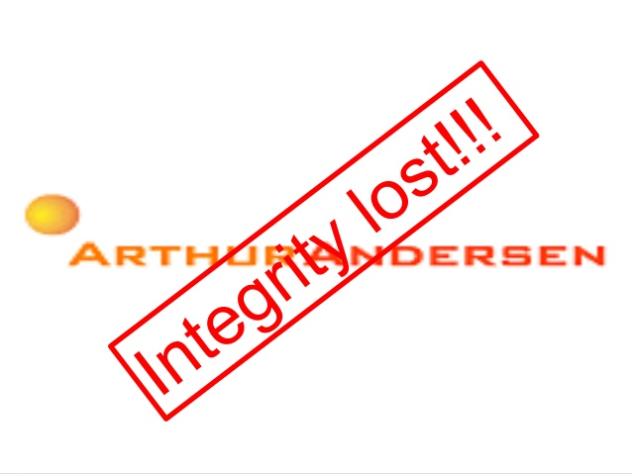
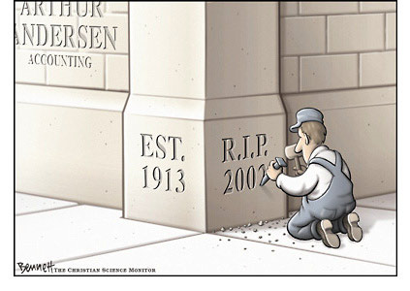
The Enron Implosion
Even worse, its auditor Arthur Andersen eventually plead guilty to obstruction of justice charges. With that plea, one the largest and trusted auditors closed its doors forever.

Slide 23
Chapter Outline
Basic Facts About Financial Structure Throughout the World
Transaction Costs
Asymmetric Information: Adverse Selection and Moral Hazard
The Lemons Problem: How Adverse Selection Influences Financial Structure
How Moral Hazard Affects the Choice Between Debt and Equity Contracts
How Moral Hazard Influences Financial Structure in Debt Markets
Conflicts of Interest

Slide 24
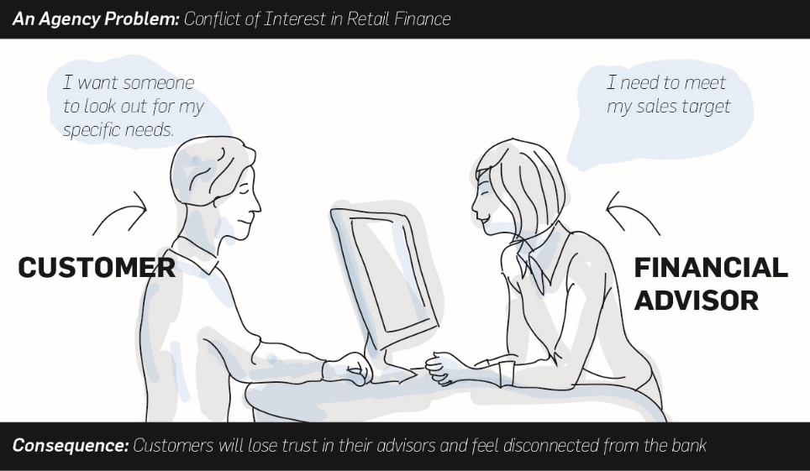
How Moral Hazard Affects the Choice Between Debt and Equity Contracts
Moral Hazard in Equity Contracts: the Principal-Agent Problem
Result of separation of ownership by stockholders (principals) from control by managers (agents)
Managers act in own rather than stockholders' interest

Slide 25

How Moral Hazard Affects the Choice Between Debt and Equity Contracts
Suppose you become a silent partner in an ice cream store, providing 90% of the equity capital ($9,000).
The other owner, Steve, provides the remaining $1,000 and will act as the manager.
If Steve works hard, the store will make $50,000 after expenses, and you are entitled to $45,000 of it.

Slide 26

How Moral Hazard Affects the Choice Between Debt and Equity Contracts
However, Steve doesn't really value the $5,000 (his part), so he goes to the beach, relaxes, and even spends some of the “profit” on art for his office.
How do you, as a 90% owner, give Steve the proper incentives to work hard?

Slide 27
How Moral Hazard Affects the Choice Between Debt and Equity Contracts
Tools to Help Solve the Principal-Agent Problem
Production of Information: Monitoring (costly state verification, free rider problem)
Government Regulation to Increase Information (explains Fact #5: heavily regulated)
Financial Intermediation (e.g., venture capital, put their own people as members of the managing body of the firm)
Debt Contracts (less frequent need to monitor the firm, and thus the lower cost of state verification).
Explains Fact # 1: Why debt is used more than equity

Slide 28
Production of Information: Monitoring
Auditing the firm frequently and checking on what the management is doing.
Problem: Costly State Verification
Problem: Free-rider
If you know that other stockholders are paying to monitor the activities of the company you hold shares in, you can take a free ride on their activities.
If you can do this, so can other stockholders.

Slide 29

Government Regulation to Increase information
Governments everywhere have laws to force firms to adhere to standard accounting principles that make profit verification easier.
Governments also pass laws to impose stiff criminal penalties on people who commit the fraud of hiding and stealing profits.

Slide 30
Financial Intermediation – Venture Capital
VC firms pool the resources of their partners and use the funds to help budding entrepreneurs start new businesses.
In exchange for use of the VC, the firm receives an equity share in the new business.
VC firms usually insist on having several of their own people participate as members of the managing body of the firm, the board of directors.
The equity in the firm is not marketable to anyone except the VC firms.
http://www.investopedia.com/terms/v/venturecapital.asp

Slide 31
Debt Contracts
If a contract could be structured so that moral hazard would exist only in certain situations, the need to monitor managers would be reduced, and the contract would be more attractive than the equity contract.
Even with the advantages just described, debt is still subject to moral hazard. In fact, debt may create an incentive to take on very risky projects.
Example:
You lend Steve the $9000 and have a debt contract that pays you in interest rate of 10%.
What if Steve use your $9000 to invest in chemical research equipment to invent in diet ice cream?

Slide 32
How Moral Hazard Influences Financial Structure in Debt Markets
Most debt contracts require the borrower to pay a fixed amount (interest) and keep any cash flow above this amount.
Tools to Help Solve Moral Hazard in Debt Contracts
Net Worth and Collateral
Incentive compatible
Monitoring and Enforcement of Restrictive Covenants.
(Free-rider problem still exist)
discourage undesirable behavior eg: to finance specific activities
encourage desirable behavior eg: life insurance
keep collateral valuable eg: prevent the sale of the car
provide information eg: accounting and income reports

Slide 33
How Moral Hazard Influences Financial Structure in Debt Markets
Tools to Help Solve Moral Hazard in Debt Contracts
Financial Intermediation—banks and other intermediaries have special advantages in monitoring
They make primarily private loans
Private loans are not traded, no free-ride issue
Explains Facts # 1–4

Slide 34
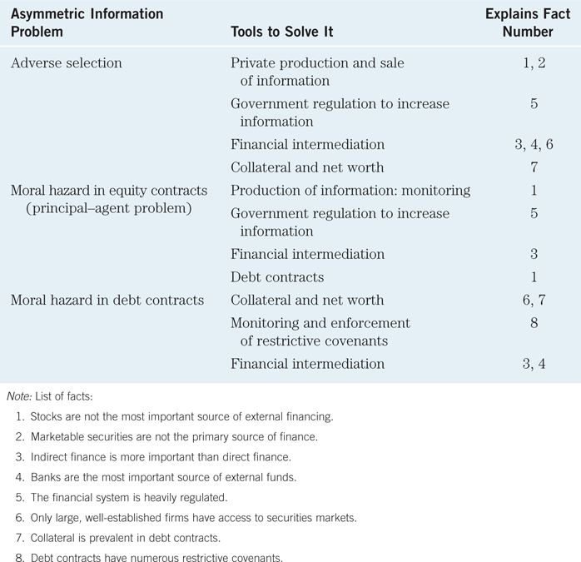
Table 7.1Summary
Asymmetric Information Problems and Tools to Solve Them

Slide 35
Case: Financial Development and Economic Growth
Financial repression leads to low growth. Why?
Poor legal system: two important tools used to help solve adverse selection and moral hazard problems in credit markets are collateral and restrictive covenants.
If the systems of property rights functions poorly, making it hard to use two tools effectively.
Government directs credit (state-owned banks) & Financial institutions nationalized: Not driven by the profit motive
Inadequate government regulation > Weak accounting standards > Cooking books > Severe asymmetric information > Hampered in channeling funds to the most productive uses

Slide 36
Chapter Outline
Basic Facts About Financial Structure Throughout the World
Transaction Costs
Asymmetric Information: Adverse Selection and Moral Hazard
The Lemons Problem: How Adverse Selection Influences Financial Structure
How Moral Hazard Affects the Choice Between Debt and Equity Contracts
How Moral Hazard Influences Financial Structure in Debt Markets
Conflicts of Interest

Slide 37
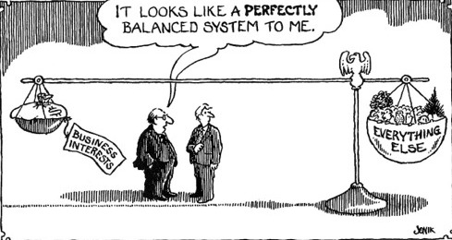
Conflicts of Interest
Conflicts of interest are a type of moral hazard that occurs when a person or institution has multiple interests, and serving one interest is detrimental to the other.
Conflicts of interest are especially likely to occur when a financial institution provides multiple services.
Economies of Scale

Slide 38
Three Types of Conflicts of Interest
Underwriting and Research in Investment Banking
Auditing and Consulting in Accounting Firms
Credit Assessment and Consulting in Rating Agencies

Slide 39
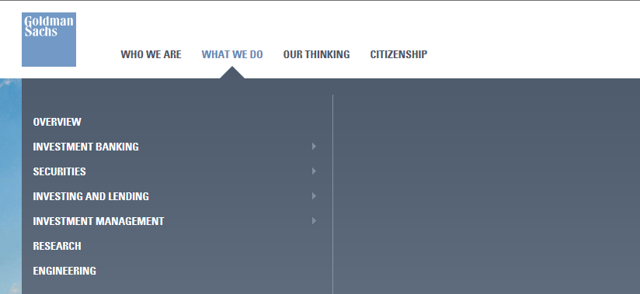
Conflicts of Interest: Underwriting and Research in Investment Banking
Investment banks may both research companies with public securities, as well as underwrite securities for companies for sale to the public.

Slide 40
Conflicts of Interest: Underwriting and Research in Investment Banking
Research
Underwriters
expected to be unbiased and accurate, reflecting the facts about the firm.
It is used by the public to form investment choices.
Underwriters will have an easier time if research is positive.
Underwriters can better serve the firm going public if the firm’s outlook is optimistic.
Underwriters can command a better price for securities issued by a firm if the firm’s outlook is optimistic.

Slide 41
Conflicts of Interest: Underwriting and Research in Investment Banking
An investment bank acting as both a researcher and underwriter of securities for companies clearly has a conflict—serve the interest of the issuing firm or the public?
During the tech boom, research reports were clearly distorted to please issuers. Firms with no hope of ever earning a profit received favorable research.
This also lead to spinning, where underpriced equity was allocated to executives who would promise future business to the investment bank.

Slide 42
Conflicts of Interest: Auditing and Consulting in Accounting Firms
Auditors check the assets and books of a firm for the quality and accuracy of the information. The objective in an unbiased opinion of the firm’s financial health.
Consultants, for a fee, help firms with variety of managerial, strategic, and operational projects.
An auditor acting as both an auditor and consultant for a firm clearly is not objective, especially if the consulting fees exceed the auditing fees.

Slide 43
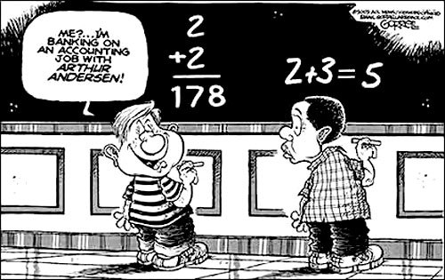
Conflicts of Interest: Auditing and Consulting in Accounting Firms
The case of Arthur Andersen, of course, epitomizes this conflict. A myriad of conflicts with its client Enron resulted in the eventual demise of Arthur Andersen when Enron collapsed.

Slide 44
Conflicts of Interest: Credit Assessment and Consulting in Rating Agencies
Rating agencies assign a credit rating to a security issuance of a firm based on projected cash flow, assets pledged, etc. The rating helps determine the riskiness of a security.
Consultants, for a fee, help firms with variety of managerial, strategic, and operational projects.
An rating agency acting as both a rater and consultant for a firm clearly is not objective, especially if the consulting fees exceed the rating fees.

Slide 45
Conflicts of Interest: Credit Assessment and Consulting in Rating Agencies
Rating agencies, such as Moody’s and Standard and Poor, were caught in this game during the housing bubble.
Firms asked the rater to help structure debt offerings to attain the highest rating possible.
When the debt subsequently defaulted, it was difficult for the agency to justify the original high rating.
Many AAA-rated products had to be downgraded over and over again until they reached junk status.
Perhaps it was just error. But few believe that—most see the rating agencies as being blinded by high consulting fees.

Slide 46
Remedies?
Sarbanes-Oxley Act of 2002
Established an oversight board to supervise accounting firms and ensure that audits are independent and controlled for quality
(Public Company Accounting Oversight Board-PCAOB)
Increased the SEC’s budget for supervisory activities
Limited consulting relationships between auditors and firms
(it is illegal for accounting firm to provide any non-audit service to a client contemporaneously with an audit)
Enhanced criminal charges for obstruction of official investigations.
Improved the quality of the financial statements and board
members of the audit committee to be independent

Slide 47
Remedies?
Global Legal Settlement of 2002
Required investment banks to sever links between research and underwriting
Spinning is explicitly banned
Imposed a $1.4 billion fine on accused 10 largest investment banks
Added additional requirements to ensure independence and objectivity of research reports
It required investment banks to make their analysts’ recommendations public
Over a five-year period, investment banks were required to contract with at least three independent research firms that would provide research to their brokerage customers.

Slide 48
Remedies?
Will these work?
It’s too early to determine yet.
However, there is much criticism over the cost involved with these separations. In other words, financial institutions can no longer take advantage of the economies of scope gained from relationships.
Some have argued that Sarbanes-Oxley has negatively impacted the value of U.S. Capital Markets. The details of that follow:

Slide 49
Mini-Case: Has SOX Led to a Decline in U.S. Capital Markets?
The cost of implementing Sarbanes-Oxley is not trivial. For companies with less than $100 million in sales, it’s estimated to be around 1% of sales.
During the same period, European countries have made it easier for firms to go public.
Both equity issuances and bond issuances are growing faster now in Europe than in the U.S.
Is it time to revisit this bill to determine if the benefits outweigh the costs?

Slide 50
The Sarbanes-Oxley Act and firms’ going-private decisions (Engle, Hayes, and Wang, 2008)
After Erron, World Telecom etc. cases, the Sarbanes-Oxley Act was intended to rebuild investors’ confidence in the capital markets.
94% of survey respondents feel that the costs of SOX compliance exceeded the benefits.
They find a significant increase in the number of firms undertaking going-private transactions in the post-SOX period compared to the pre-SOX period.
SOX compliance costs are more burdensome for smaller and less liquid firms.

Slide 51
Chapter Outline
Basic Facts About Financial Structure Throughout the World
Transaction Costs
Asymmetric Information: Adverse Selection and Moral Hazard
The Lemons Problem: How Adverse Selection Influences Financial Structure
How Moral Hazard Affects the Choice Between Debt and Equity Contracts
How Moral Hazard Influences Financial Structure in Debt Markets
Conflicts of Interest

